Slide 1



Development of an Assistive Exoskeleton for a Space Suit
Dom Belasquez
Mentor: Dr. Reza Sharif Razavian
Additional Acknowledgement: Jose Ben
NAU Steve Sanghi College of Engineering
NAU Department of Astronomy and Planetary Science

Slide 2
Introduction
2 of 16

Slide 3
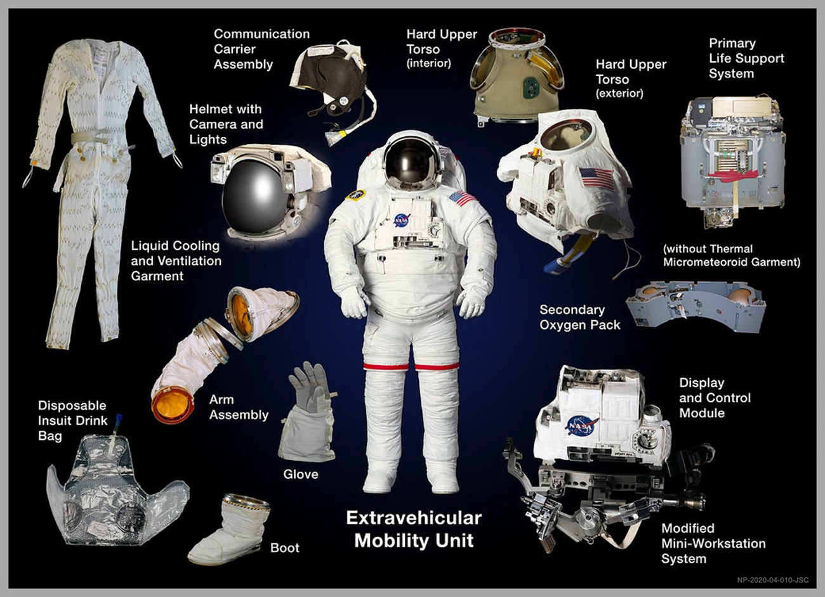
The Extravehicular Activity (EVA) Mission
Long Duration: ~7 hours [1]
NASA’s Primary EVA Space Suit: Extravehicular Mobility Unit (EMU)
Heavy: ~114 kg (No User) [1]
Bulky: 14 material layers [1]
Figure 1: EMU Diagram. Adapted from [2]
[1] NASA, “The Space Shuttle Extravehicular Mobility Unit (EMU),” in Suited for Spacewalking: A Teacher’s Guide with Activities for Technology Education, Mathematics, and Science, DC: Office of Human Resources and Education, 1998, pp. 17-30. [E-Book]
[2] NASA, “The Extravehicular Mobility Unit (EMU),” National Aeronautics and Space Administration. https://www.nasa.gov/image-article/extravehicular-mobility-unit-emu/
3 of 16

Slide 4
Problem Definition
Problem
Solution
More difficult motion in EMU suit [3]
Reduce Energy
Reduce Fatigue
Sweat and Moisture Buildup
Extra Energy Expenditure
Assistive Power Exoskeleton
Discomfort, Excessive Sweat, Skin Irritation, Fatigue [3]
[3] J. Dunn, E. Benson, J. Norcross, and N. Newby, “Evidence Report: Risk of Injury and Compromised Performance Due to EVA Operations,” NASA, 2022.
4 of 16

Slide 5
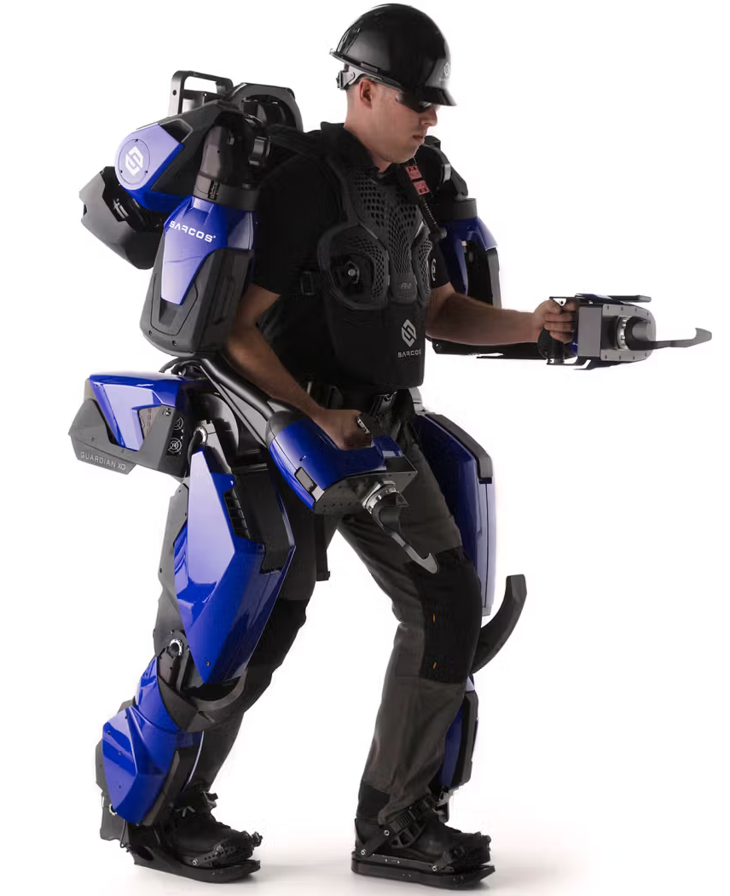
Power Exoskeleton Challenges
Bulky
Heavy: 114 kg [4]
Powerful: Lifts 850+ N [4]
Figure 2: Sarcos Robotics Guardian XO Industrial Exoskeleton. Adapted from [4]
EMU suit is already big and heavy: Integrating a large power exoskeleton would worsen the problem
Exoskeleton Needs: Lightweight, low volume, assistive power delivery
[4] Sarcos Robotics, “Robots: Guardian XO,” IEEE, 2020. https://robotsguide.com/robots/guardianxo
5 of 16

Slide 6
Research Question
Can a lightweight and low volume exoskeleton assist in reducing user effort?
6 of 16

Slide 7
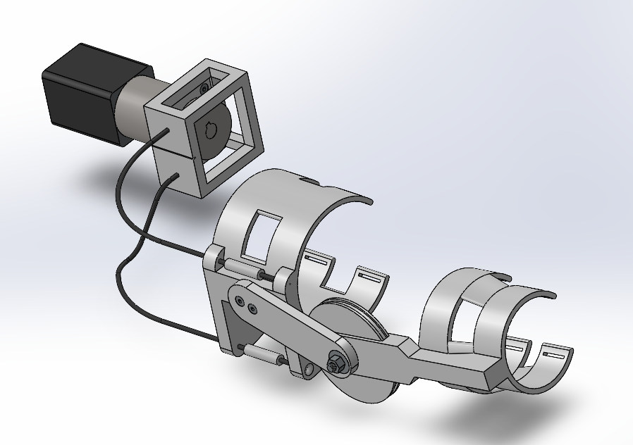
The Design
Elbow (Single Joint) Actuation Focus: 1 degree of freedom
Motor: Stepper motor
Cable Driven: Bowden cable
3D Printed PLA
Lightweight: <3 kg
Low Volume: ~1.14 x 10⁻³ m³
Figure 3: CAD (SolidWorks) Model
7 of 16

Slide 8
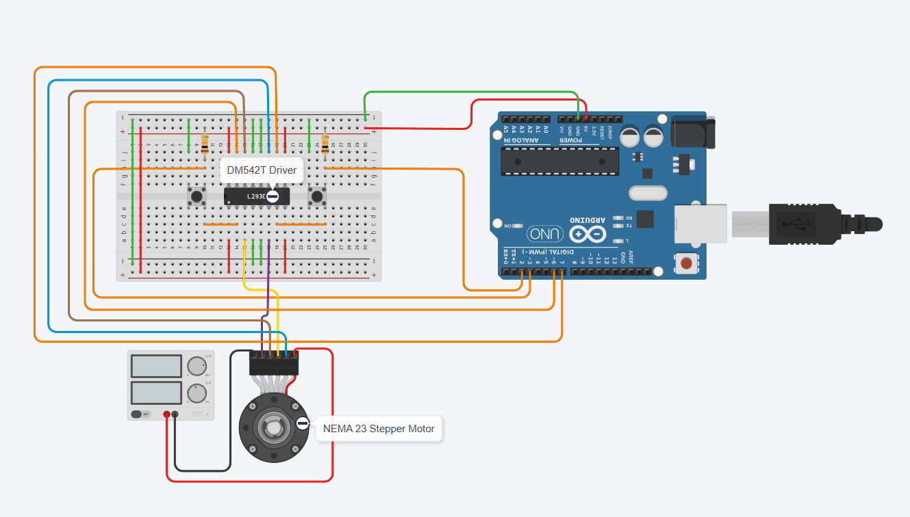
Experimental Setup
Controller: Manual control with Arduino Uno using 2 buttons
Power Delivery: Workbench power supply (24V @ 2.3A)
Experiments Ran:
Actuation while not worn
Actuation while worn
Actuation while worn + held mass
Figure 4: Experiment Wiring Diagram
8 of 16

Slide 9
Testing and Results
9 of 16

Slide 10
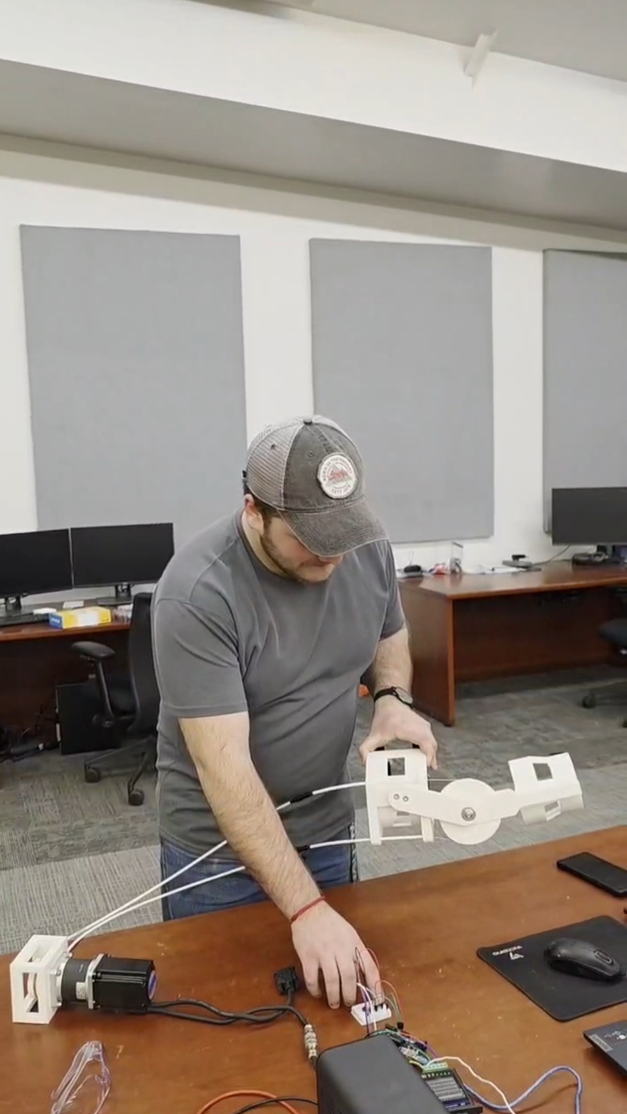
Experiment: Actuation While Not Worn
10 of 16

Slide 11
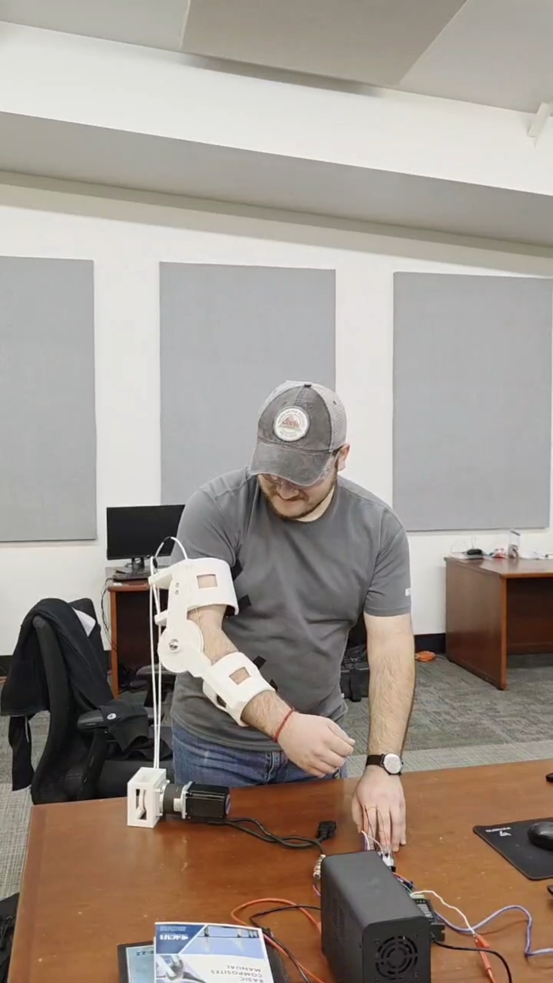
Experiment: Actuation While Worn
11 of 16

Slide 12
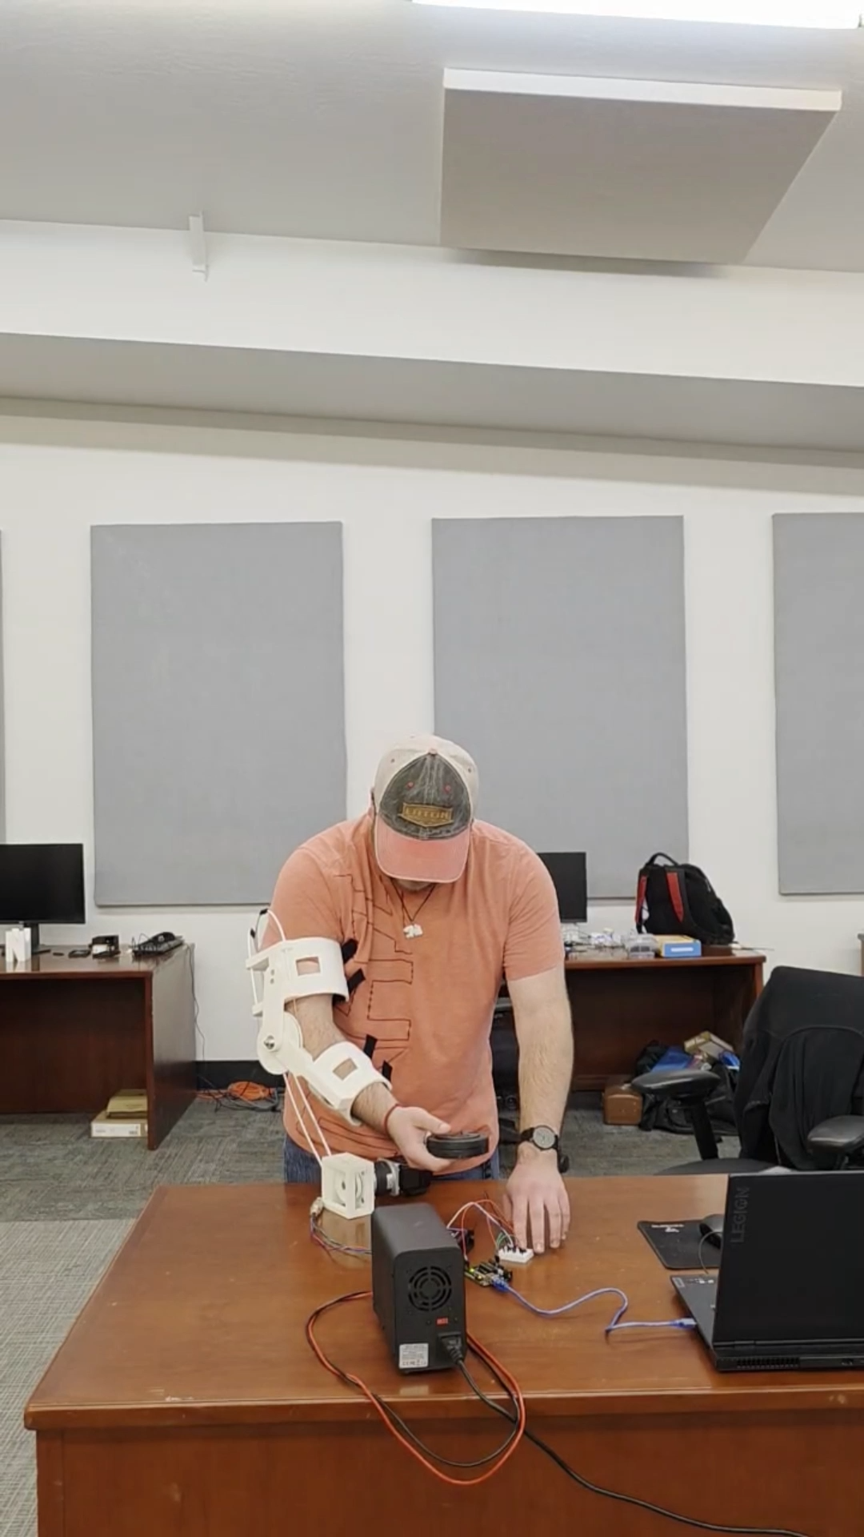
Experiment: Actuation While Worn + Held Mass
12 of 16

Slide 13
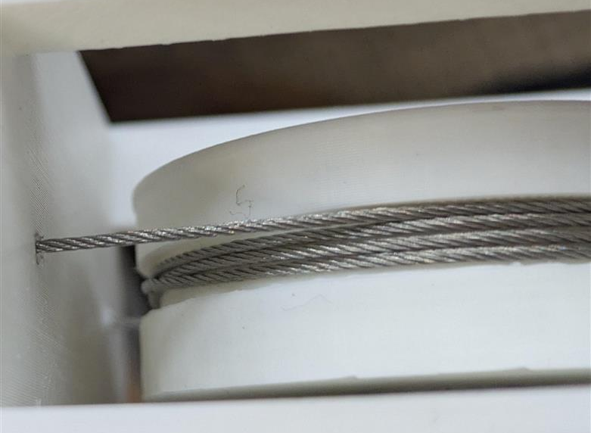
Results
Positive Outcomes
Limitations
Max Lift Test: 10 N
Reliable: Lifted relaxed arm with miminal slippage
Smooth operation: Motion felt natural
Difficult to Apply Preload Tension: Slipped under heavier loading
Uncomfortable: Not tailored correctly to arm
Cable Routing Issue: Cables began to overlap and lose preload tension
Figure 5: Cable Overlap on Motor Pulley
Conclusion: This mechanism for power actuation from a small, lightweight forearm exoskeleton can assist a user in movement!
13 of 16
Notes:
Don’t say water bottle, add animations, increase graphics, give design reasons for positives and negatives, just say handheld mass

Slide 14
Future Considerations
14 of 16

Slide 15
Future Work
Prototype Improvements
Increase Comfort: Increase brace flexibility and adjustability
Improve Tensioning Mechanism and Cable Routing
Increase Material Strength: Possible composite use
Increase Cable Strength: Cable strength close to 10 N load tension [4]
Design Additions
Integration with EMU Suit
Make Exoskeleton Battery Powered
Integrate Haptic Feedback
Make Backward’s Drivable
[4] TECNI, “Stainless Steel Cable 7x7 (Flexible),” TECHNI Ltd, Tech. Rep. CABLE-GP-SS-77, 2020.
15 of 16

Slide 16

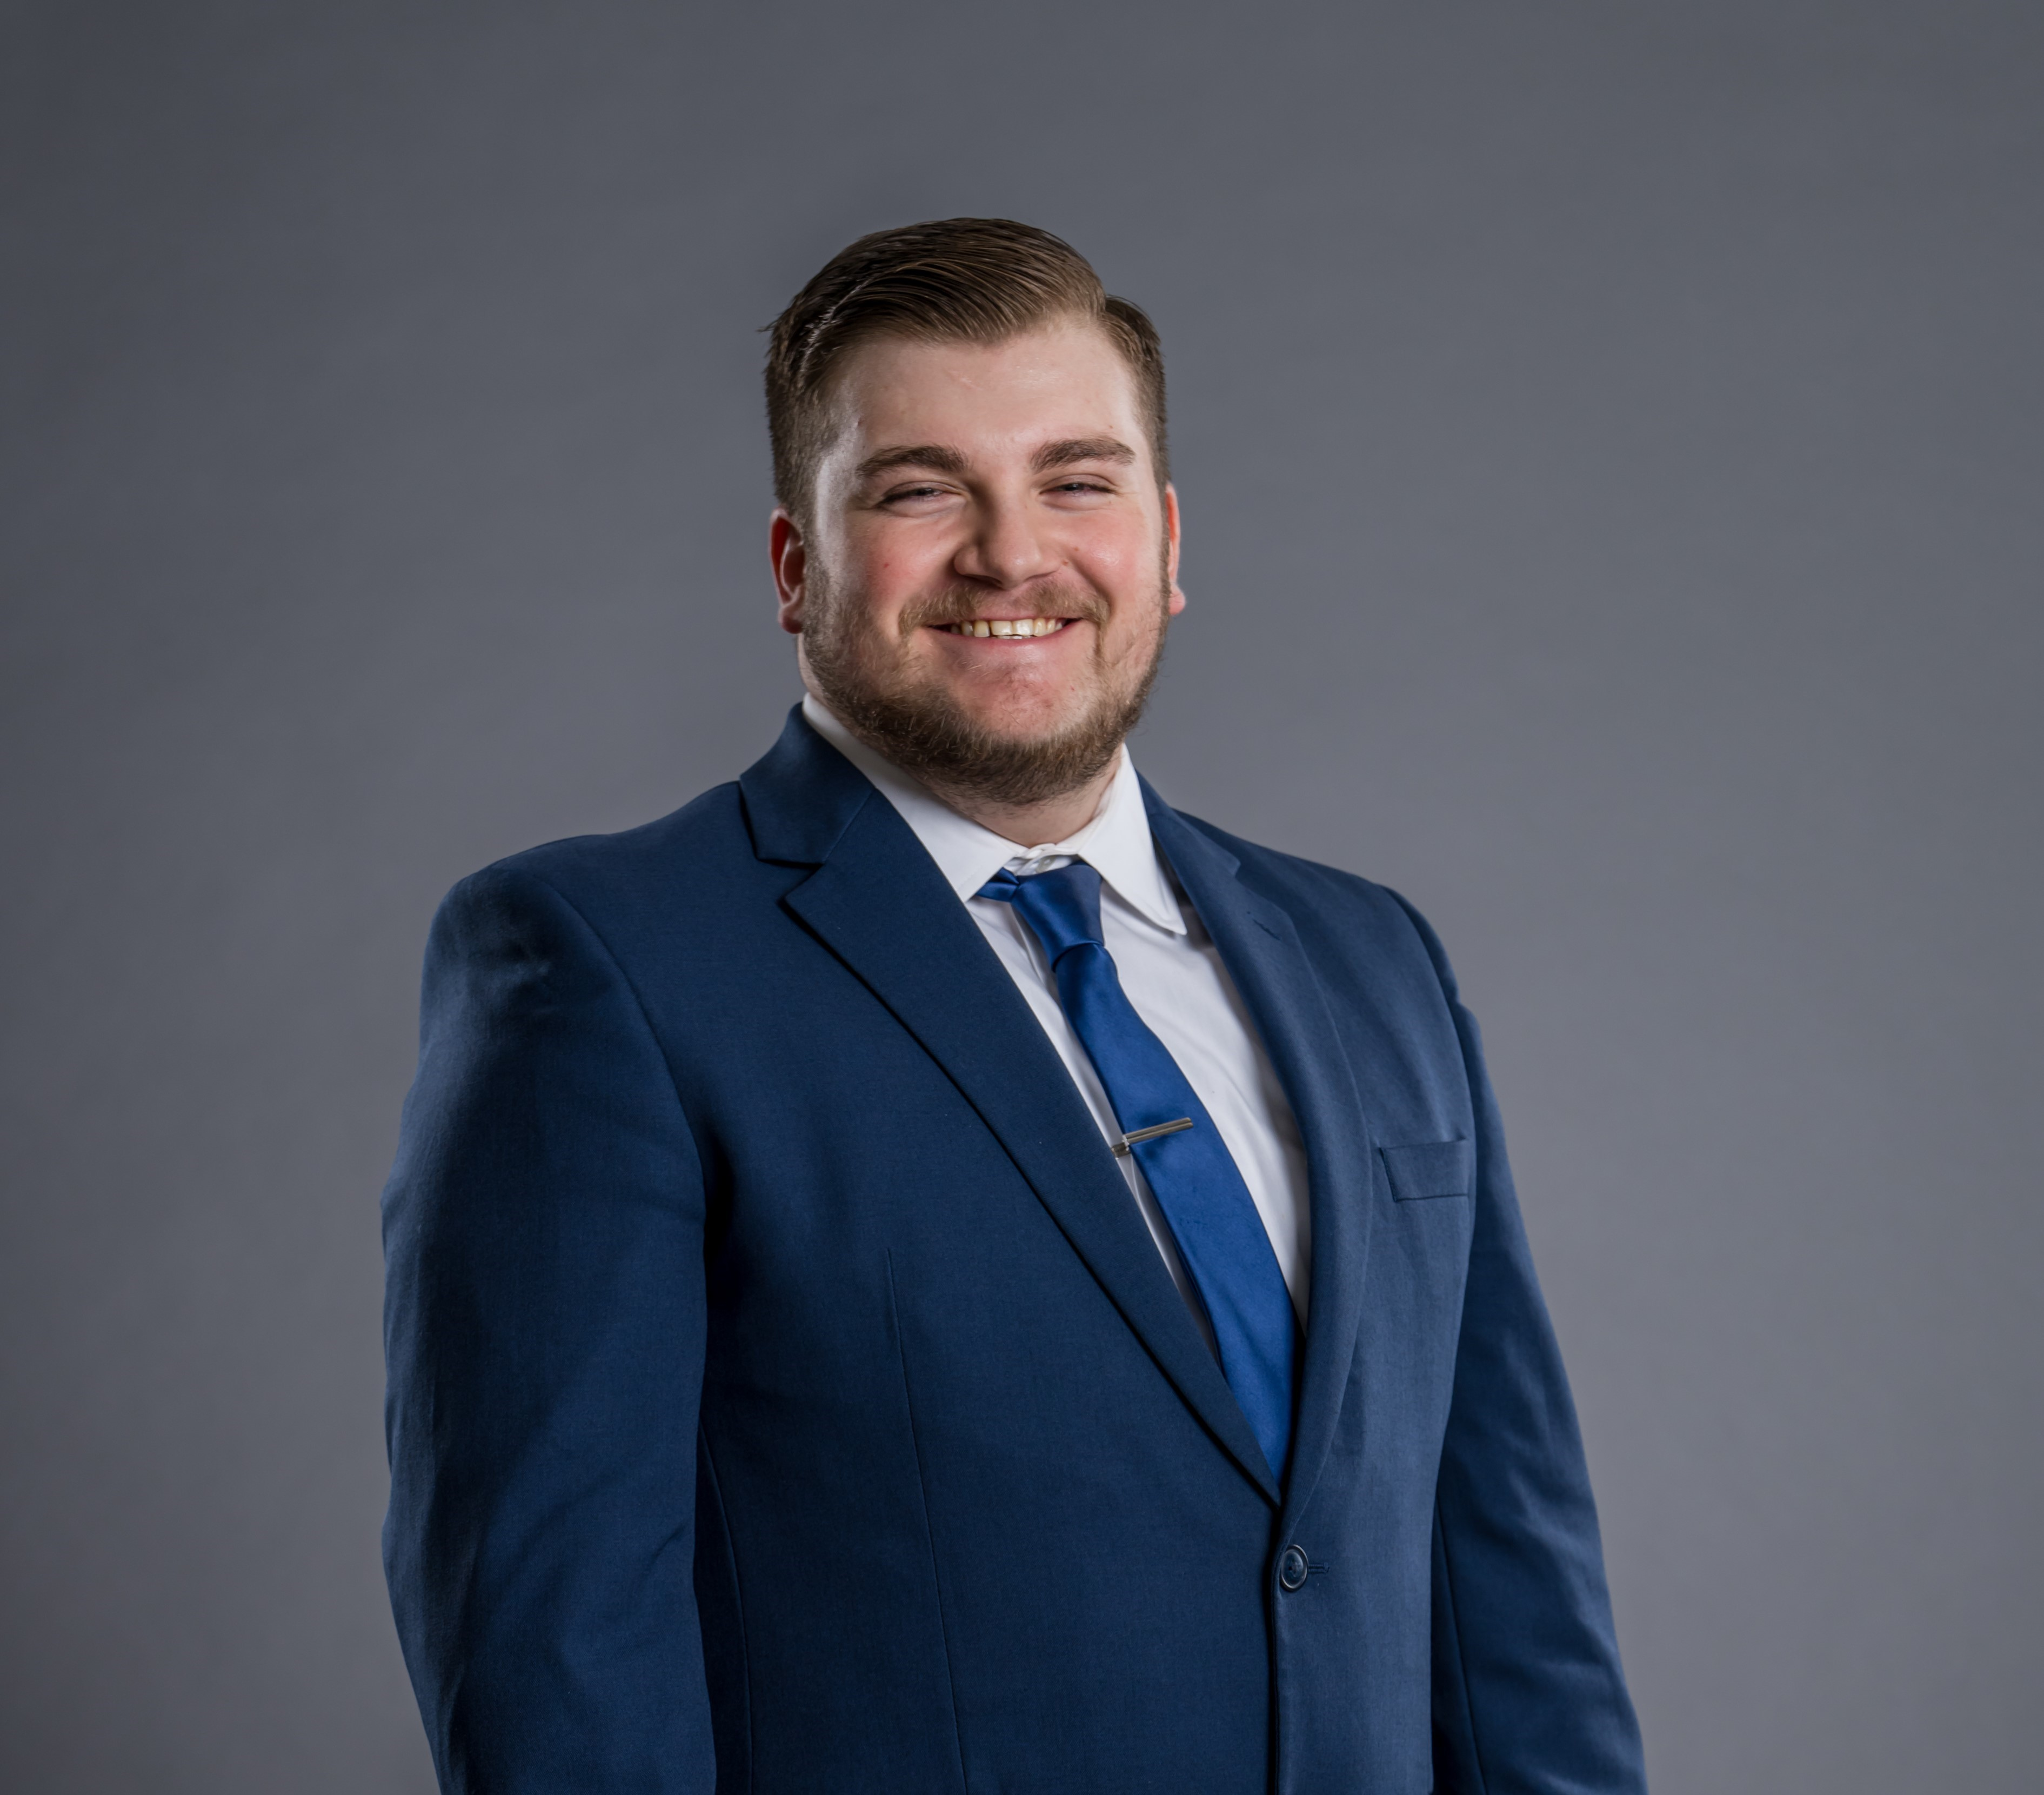
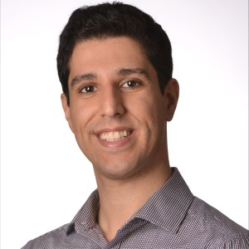
Thank you!
Questions?
Jose Ben
Dom Belasquez
Dr. Reza Sharif Razavian
16 of 16
Notes:
Picture of Jose, Reza, Thank Space Grant Consortium for funding and opportunity

